Slide 1
Making this resource work for you
Prior to teaching this lesson, please refer to the ‘Unit Overview and Planning Document’.
Further guidance on planning Science Mastery lessons can be found in the detailed planning guidance document.
Refer to the ‘notes’ section on each slide for useful information, including suggested expositions, pedagogical content knowledge, suggested questions, answers and more. Consider using presenter mode so you can see this guidance throughout the lesson.
The introduction slides can be adapted to suit your teaching style and the needs of your class.
Before the lesson, adapt the fix-it slide to address any misconceptions identified in the previous lesson’s exit ticket.
Choose from the suggested activities to suit your class. The intention is not that you complete all of these, but that you select those which ones are most appropriate for your students. It may be appropriate to further adapt activities for your students.
These lessons are designed to occupy approximately 1 hour. To adapt for a shorter or longer lesson duration we advise you to adapt the activity section accordingly.
Please consider using the final slide to send feedback about this lesson or examples of PowerPoints that you have adapted to our design team. Your feedback is used to improve Science Mastery for all of our teachers and students. We appreciate all suggestions and comments.
Thank you for reading!
The Science Mastery Team

Slide 2

Taking it Further: Alcohols
Answer the questions below.
State the general formula of the alkanes.
State the general formula of the alkenes.
Explain how bromine water could be used to identify an alkane and an alkene.
Define a hydrocarbon.
Name the type of bonding present in alkanes and alkenes.
C_{n}H_{2n+2}
C_{n}H_{2n}
Add bromine water to each, the alkene would turn bromine water colourless, and the alkane would have no effect so bromine water would stay orange.
A molecule that contains carbon and hydrogen atoms only.
Covalent
Notes:
Big idea: Reactions rearrange matter
Foundation: Name the alkane with one carbon.
Stretch: Explain why the first alkene is ethene.
Answers:
Foundation: Methane
Stretch: As the functional group for alkenes is the C=C double bond, which requires a minimum of two carbon atoms.

Slide 3
Taking it Further: Alcohols
Do Now:
State the general formula of the alkanes.
State the general formula of the alkenes.
Explain how bromine water could be used to identify an alkane and an alkene.
Define a hydrocarbon.
Name the type of bonding present in alkanes and alkenes.
Drill:
Ethanol has the chemical formula C₂H₅OH.
Identify how many of each type of atom are present in a molecule of ethanol.
Calculate the relative formula mass of ethanol. C=12, H=1, O=16
Calculate the percentage by mass of hydrogen in ethanol.
Notes:
Drill answers:
2 carbon atoms, 6 hydrogen atoms and 1 oxygen atom.
(2x12)+(6x1)+16 = 46
6/46 x100 = 13.04 %

Slide 4
Taking it Further: Alcohols
Read Now:
When the word alcohol is used, it generally means an alcoholic drink, such as wine or beer. However, alcohol is actually a homologous series of compounds so there is more than one type of alcohol. The type of alcohol in alcoholic drinks is ethanol, which as the prefix suggests, contains two carbon atoms. Drinking pure ethanol would be dangerous for the body, so most alcoholic drinks contain between 2% and 40% ethanol. In the short term, ethanol interferes with communication pathways in the brain, slowing down nerve impulses. This can cause slurred speech, slow reactions and impaired judgement, which is why it is illegal to drink and drive. In the long term, excessive alcohol consumption can cause liver damage and seriously impact mental health.
Name the type of alcohol found in alcoholic drinks.
Identify how many carbon atoms are found in ethanol.
Explain why most alcoholic drinks only contain 2%-40% ethanol.
Describe some short-term effects of drinking alcohol.
Describe some long-term effects of excessive alcohol consumption.

Slide 5

C5.1.7
01/10/2025
Taking it Further: Alcohols
C5.1.1 Prior Knowledge Review
C5.1.2 Crude Oil and Hydrocarbons
C5.1.3 Fractional Distillation
C5.1.4 Combustion of Hydrocarbons
C5.1.5 Cracking
C5.1.6 Taking it Further: Alkenes
C5.1.7 Taking it Further: Alcohols
C5.1.8 Taking it Further: Producing Ethanol by Fermentation
C5.1.9 Taking it Further: Producing Ethanol from Ethene
C5.1.10 Taking it Further: Carboxylic Acids
C5.1.11 Taking it Further: Esters
C5.1.12 Polymers
C5.1.13 Taking it Further: Addition Polymerisation
C5.1.14 Taking it Further: Condensation Polymerisation
C5.1.15 Taking it Further: Naturally Occurring Polymers
Notes:
Big Idea: Structure Determines Properties
In this lesson, students will meet another homologous series. Following this, students will look at the two different methods of producing ethanol to evaluate the advantages and disadvantages of each.
Suggested Hook:
What happens to the body when you drink alcohol?
What are some of the diseases that alcohol is a risk factor for?

Slide 6

Following this lesson, students will be able to:
Draw structural formulae for alcohols
Describe uses of alcohols
Describe chemical reactions of alcohols
Key Words:
alcohol
ethanol
hydroxyl
solvent
solubility
Notes:
Guidance:
See unit overview document and planning guidance to see how these objectives are typically assessed at GCSE, including examples of what students should be able to do following this lesson.
Planning for different needs:
The learning objectives given on this slide are suggested based on the most common requirements for exams, however they can be adapted based on the needs of different classes.
For best practice, the unit preparation booklet should be used to determine the appropriate focus of lessons within the unit.
While it is not possible to explicitly split content into levelled grades, we recommend that lesson objectives can be classified as critical, core or stretch.
Critical: the content or skill is essential for all students to be able to progress.
Core: the content or skill is important for students to progress, but other opportunities may be available to revisit it.
Stretch: the content or skill may not be essential for all students but is important for students aiming for the highest grades.
Key skill: this is a crucial skill being developed in this unit as part of the skill mapping
C5.1.7 Lesson Objectives:
Critical: Draw structural formulae for alcohols
Critical: Describe uses of alcohols
Stretch: Describe chemical reactions of alcohols

Slide 7
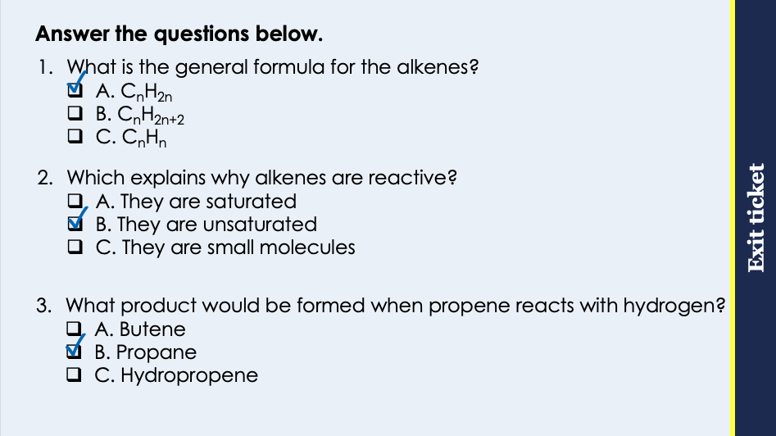
This is the fix-it portion of the lesson
The fix-it is an opportunity to respond to gaps in knowledge, especially those identified by the pre-unit quiz.
The teacher should customise this slide as needed, to facilitate
reteach, explanation, demonstration or modelling of ideas and concepts that students have not yet grasped or have misunderstood.
practise answering specific questions or of key skills.
redrafting or improving previous work.
Notes:
Purpose: to spend time on any gaps identified in previous learning from previous exit ticket.
Guidance from previous exit ticket:
Q1. Answer: A
If students answer B, they have confused the general formulae for alkanes and alkenes. If students answer C, they have made the common mistake of noticing that there is no +2 but have forgotten that the number of hydrogens is still 2x the number of carbons. To fix it, review the general formula for the alkenes.
Q2. Answer: B
If students answer A, they are not clear on the difference between a saturated and an unsaturated molecule. If students answer C, they have confused the physical and chemical properties. To fix it, review what happens when alkenes react with hydrogen or bromine.
Q3. Answer: B
If students answer A, they may have the misconception that the name of the compound comes from the number of hydrogens rather than carbons. If students answer C, they have confused hydrogenation with naming convention from a bromine addition reaction. To fix it, review the different products that can be made though the alkene reactions.

Slide 8
Alcohols
The alcohols are another homologous series that contain a hydroxyl (OH) group.
Methanol
Propanol
CH₃OH
C₃H₇OH
H
Ethanol
H
H
H
H
C
O
H
C₂H₅OH
H
C
C
C
O
H
Butanol
C₄H₉OH
H
H
H
H
H
H
H
H
H
H
H
C
C
O
H
H
C
C
C
C
O
H
H
H
H
H
H
H
Notes:
Suggested exposition:
We have already seen two different homologous series: the alkanes and the alkenes. In this lesson, we’re going to look at another group: the alcohols. Usually when people describe alcohol, they mean alcoholic drinks, which contain a compound called ethanol. Ethanol is one type of alcohol, part of a family of compounds.
The functional group of the alcohols is called a hydroxyl group: OH. This is not the same as a hydroxide ion. This hydroxyl group is responsible for the properties of the alcohols.
As with the alkanes and alkenes, the naming conventions are based on the number of carbon atoms in the molecule. As alcohols also contain an oxygen atom, they are not hydrocarbons. As alcohols do not have a C=C double bond, there can be an alcohol with one carbon atom, which is methanol.
The first four members of the alcohols are methanol, ethanol, propanol and butanol. You can see in their structural formulae that they all contain the OH hydroxyl group. This can be drawn on either end of the molecule but does not change the formula. The chemical formula is written with the OH separate to the other hydrogen atoms so it is clear that the molecule is an alcohol.
Oxygen is in group 6. How many electrons does an oxygen atom have in its outer shell?
6.
How many bonds does it need to make to achieve a full outer shell?
2.
This is why there is one bond formed between the oxygen atom and the carbon atom and one bond formed between the oxygen atom and the hydrogen atom. The hydroxyl group must be connected by the oxygen as the hydrogen atom can only make one bond.

Slide 9
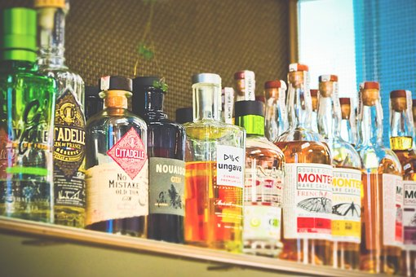
Uses of Alcohols
The alcohols have a number of different uses.
Methanol is used as a chemical feedstock.
Ethanol is used in alcoholic drinks, as a fuel or a solvent.
Propanol and butanol are used as fuels or solvents.
Methanol and ethanol are highly soluble in water.
Solubility decreases as the length of an alcohol chain increases.
Notes:
Suggested exposition:
The alcohols have a number of different uses.
Methanol, the first of the alcohols, is useful for many different chemical reactions so is used as a chemical feedstock. Remember this just means a chemical that can be used in different chemical reactions to make different products. Methanol is toxic, so in cases where ethanol is made for industry, methanol can be added to it to make it unsafe to drink and deter people from drinking industrial ethanol.
Ethanol is the most well known alcohol, as it is the alcohol present in alcoholic drinks (in different quantities). It can also be used as a fuel or a solvent.
What is a solvent?
A liquid that a solute dissolves in.
What is a fuel?
A substance that undergoes a chemical reaction (such as combustion) to release energy.
Some of the alcohols can be used as solvents but some of them can also be dissolved in water themselves. The alcohols with the shortest chains (methanol and ethanol) are highly soluble in water, so they mix easily to form a solution. This is why in clear alcohol drinks, it looks like one clear liquid, rather than separate layers of ethanol and water. As the length of alcohol chains increases, solubility decreases, so alcohols longer than butanol become less soluble in water and may not mix easily into solutions, forming separate layers.
Image from pixabay

Slide 10
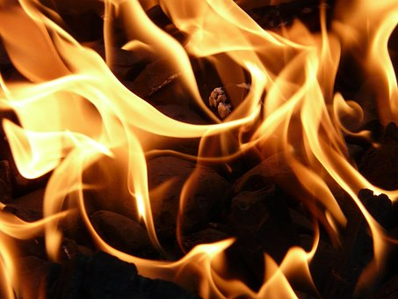
Reactions of Alcohols
Some of the alcohols can be used as fuels because they undergo combustion.
For example:
Ethanol + oxygen → carbon dioxide + water
C₂H₅OH + 3 O₂ → 2 CO₂ + 3 H₂O
Alcohols also react with sodium.
For example:
Ethanol + sodium → sodium ethoxide + hydrogen
2 C₂H₅OH + 2 Na → 2 C₂H₅ONa + H₂
Notes:
Suggested exposition:
Some of the alcohols can be used as fuels because they undergo combustion, which is an exothermic reaction to release energy.
For example, complete combustion of ethanol produces carbon dioxide and water, similarly to complete combustion of the alkanes.
Alcohols can also undergo incomplete combustion.
What is the difference between complete and incomplete combustion?
Complete combustion happens when there is a plentiful supply of air/oxygen.
The products of incomplete combustion of alcohols are the same as the products of incomplete combustion of alkanes.
What are theses products?
Water, carbon and carbon monoxide.
Alcohols also react with sodium. If a small piece of sodium is dropped into ethanol, bubbles of hydrogen gas are produced and the liquid contains sodium ethoxide.
For example: ethanol reacts with sodium to form sodium ethoxide and hydrogen gas. This can be represented with a chemical equation.
Methanol, propanol and butanol all react with sodium in a similar why.
Why should only a small piece of sodium be dropped into the alcohol?
Because sodium is very reactive so the reaction may produce hydrogen gas very vigorously.
Image from pixabay

Slide 11




Which statements do you agree with?
Alcohols can be used as solvents
Methanol, ethanol and propanol are used in alcoholic drinks
Alcohols contain a double bond
Alcohols are hydrocarbons
Notes:
Suggested points:
This talk task is designed to ensure that students are clear on the properties of the different fractions, drawing out if they understand the difference between high and low volatility and viscosity.
Blue: incorrect
Yellow: correct
Green: incorrect
Pink: incorrect - they also contain oxygen atoms so they cannot be called hydrocarbons
Suggested guidance:
Talk tasks can be used in a variety of ways to suit the particular needs of the students you are teaching. Through exchanging views with others, students develop their understanding of the science beyond what could be achieved individually.
Science classrooms that successfully integrate talk have the following features:
Science talk is a regular feature of lessons and is woven into classroom activities.
Students are paired or grouped strategically by the teacher to ensure productive interaction. This might take into consideration the students’ proficiency of the English language, how encouraging they might be to peers and their attainment in the topic. It’s a good idea to consider these pairings in the class seating plan.
Students are encouraged and supported to talk, but are not forced to talk.
The teacher should take on the role of a facilitator, engaging with conversations where necessary and encouraging or steering the conversation where needed.
Students are encouraged to use the language they have to express their ideas (e.g., everyday language, imperfect English, native language), but also to incorporate science specific terminology where this is more accurate or has been taught.
6. Scientifically inaccurate ideas are not dismissed by the partner or teacher; open discussion and further investigation are relied on to help students construct ideas that support them to progress in their scientific understanding.
7. Guidelines for behaviour during talk tasks are explicit and frequently reviewed. Rules for students might be:
Listen carefully to your partner
Take turns talking.
Speak one at a time, without interrupting.
Politely agree or disagree and explain why.
Politely point out if your partner has used a scientific word incorrectly, if they have explained the science incorrectly, or if there is a more accurate way to describe something.
If confused, ask questions.
Stay focused on the discussion topic.
Respond to one another.

Slide 12
What is the general formula of alcohols?
Methanol
CH₃OH
Propanol
C₃H₇OH
Ethanol
C₂H₅OH
Butanol
C₄H₉OH
C_{n}H_{2n+1}OH

Slide 13
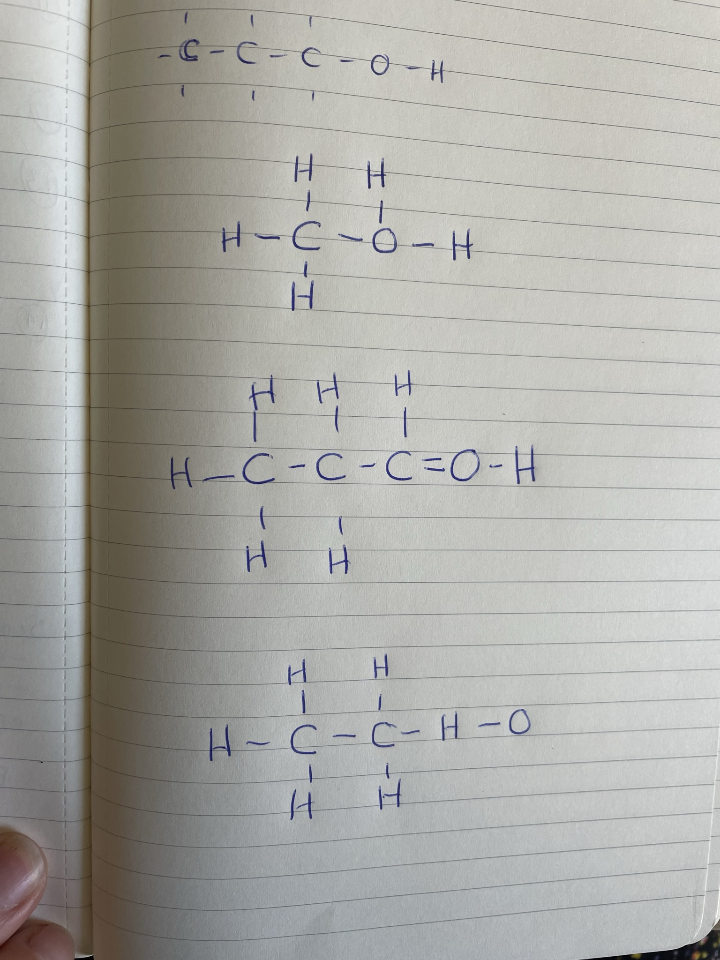
Can you explain the mistake in each of these structural formulae?
A
C
B
Notes:
A: Oxygen can only make two bonds so there is an extra hydrogen atom attached to the oxygen
B: The hydrogen and oxygen atoms of the hydroxyl group are the wrong way round
C: There should not be a double bond between C and O

Slide 14
Drill
State the names of the first four alcohols.
State the chemical formula for ethanol.
Give a use of methanol.
Give a use of ethanol.
Give a use of propanol.
State the products of the reaction between ethanol and sodium.
Describe the pattern of solubility of alcohols with size of molecules.
Notes:
Purpose: This is a knowledge drill. The purpose of this is to check that the critical knowledge is secure before pupils move onto independent practice.
Suggested guidance: There are a range of ways this could be done depending on time and ability range of the class:
Mini whiteboards
As full sentences in exercise books
As short answers in exercise books
In the pupil workbook
As pair talk
As cold call

Slide 15
Drill answers
Methanol, ethanol, propanol, butanol
C₂H₅OH
As a chemical feedstock
As a solvent or in alcoholic drinks
As a solvent or a fuel
Sodium ethoxide and hydrogen gas
The larger the molecule (the longer the chain), the less soluble it is
Notes:
Purpose: This is a knowledge drill. The purpose of this is to check that the critical knowledge is secure before pupils move onto independent practice.
Suggested guidance: There are a range of ways this could be done depending on time and ability range of the class:
Mini whiteboards
As full sentences in exercise books
As short answers in exercise books
In the pupil workbook
As pair talk
As cold call

Slide 16
I: Alcohol formulae
Determine the chemical formula of this compound.
H
H
H
H
H
C
C
C
C
O
H
H
H
H
H
C₄H₉OH
Name this chemical compound.
Butanol
Give a use of this chemical compound.
A solvent or fuel
Notes:
Purpose: The I-We-You section aims to support pupils to build skills that they most commonly need when answering questions associated with this knowledge in the assessment. This section is also used to interleave other content we expect pupils to know at this stage of their education in order that they build a big picture of the science they are learning.
For the ‘I’ activity, the teacher should model how to answer the question. They can do this by narrating their thinking process aloud, and making links to learning earlier in the lesson explicit.
For the ‘we’ activity, the teacher and students work though a similar example together, in order to prepare students to be able to answer a similar question independently.
Opportunities for the ‘you’ activity – independent practise – occur in the activity portion of the lesson once the student is secure enough to process independently.

Slide 17
We: Alcohol formulae
Determine the chemical formula of this compound.
H
H
H
H
C
C
C
O
H
H
H
H
C₃H₇OH
Name this chemical compound.
Propanol
Give a use of this chemical compound.
A solvent or fuel
Notes:
Purpose: The I-We-You section aims to support pupils to build skills that they most commonly need when answering questions associated with this knowledge in the assessment. This section is also used to interleave other content we expect pupils to know at this stage of their education in order that they build a big picture of the science they are learning.
For the ‘I’ activity, the teacher should model how to answer the question. They can do this by narrating their thinking process aloud, and making links to learning earlier in the lesson explicit.
For the ‘we’ activity, the teacher and students work though a similar example together, in order to prepare students to be able to answer a similar question independently.
Opportunities for the ‘you’ activity – independent practise – occur in the activity portion of the lesson once the student is secure enough to process independently.

Slide 18
You: Alcohol formulae
Determine the chemical formula of this compound.
H
H
H
C
C
O
H
H
H
C₂H₅OH
Name this chemical compound.
Ethanol
Give a use of this chemical compound.
A fuel, a solvent or in alcoholic drinks
Notes:
Purpose: The I-We-You section aims to support pupils to build skills that they most commonly need when answering questions associated with this knowledge in the assessment. This section is also used to interleave other content we expect pupils to know at this stage of their education in order that they build a big picture of the science they are learning.
For the ‘I’ activity, the teacher should model how to answer the question. They can do this by narrating their thinking process aloud, and making links to learning earlier in the lesson explicit.
For the ‘we’ activity, the teacher and students work though a similar example together, in order to prepare students to be able to answer a similar question independently.
Opportunities for the ‘you’ activity – independent practise – occur in the activity portion of the lesson once the student is secure enough to process independently.

Slide 19
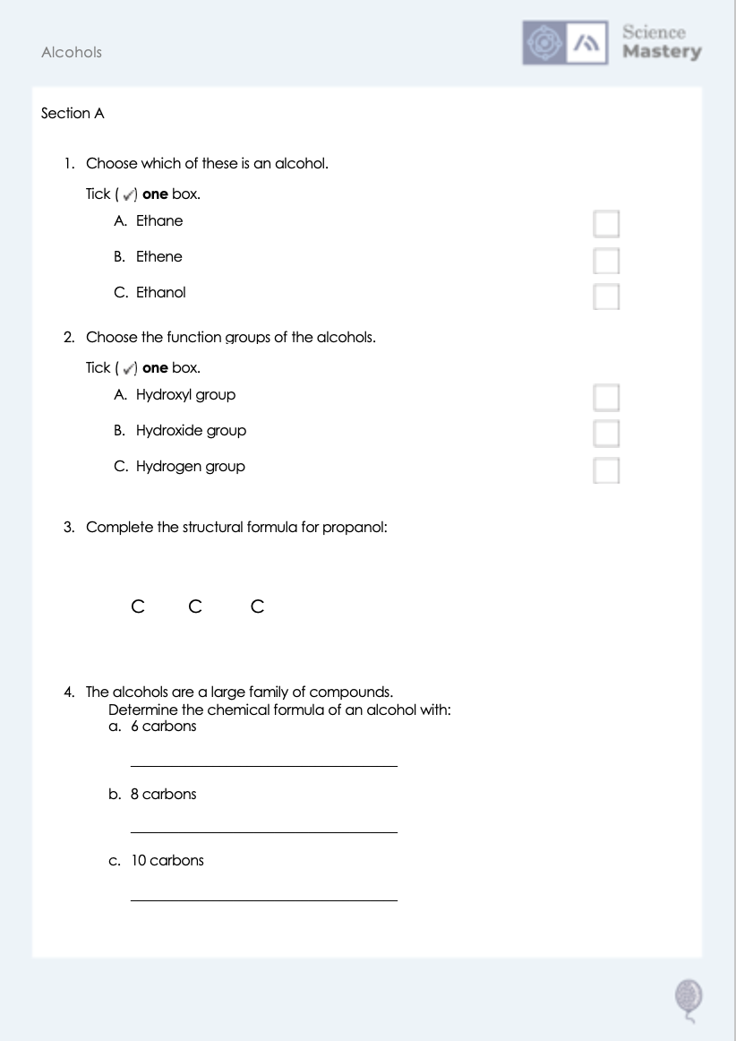
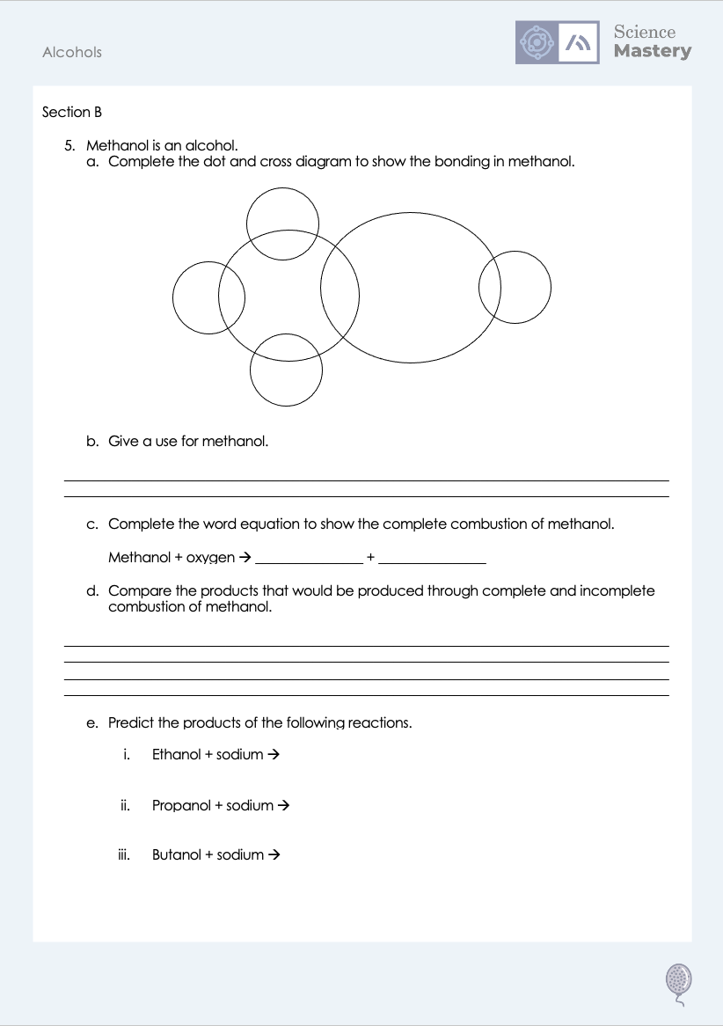
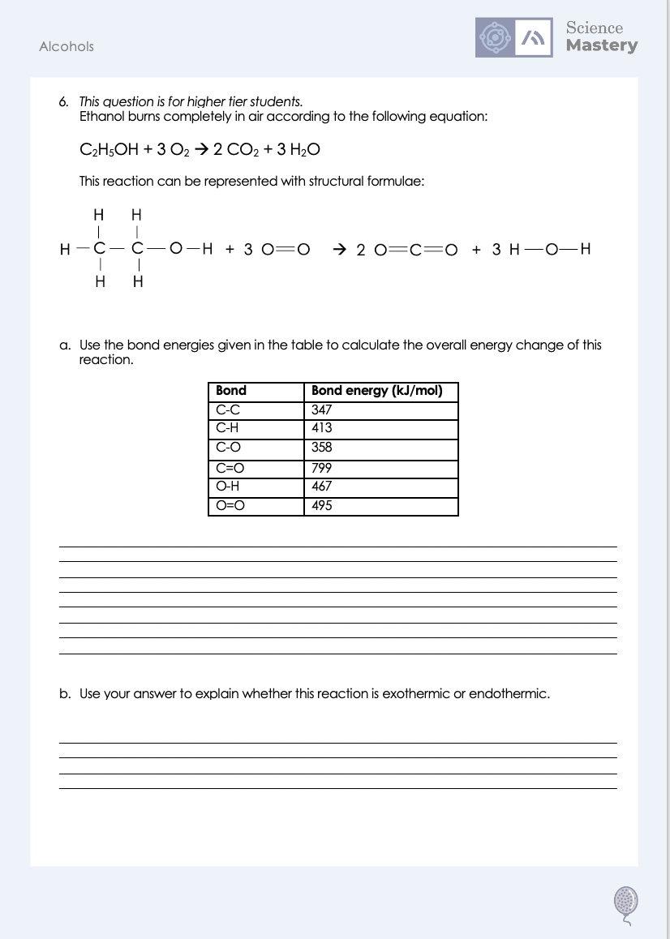
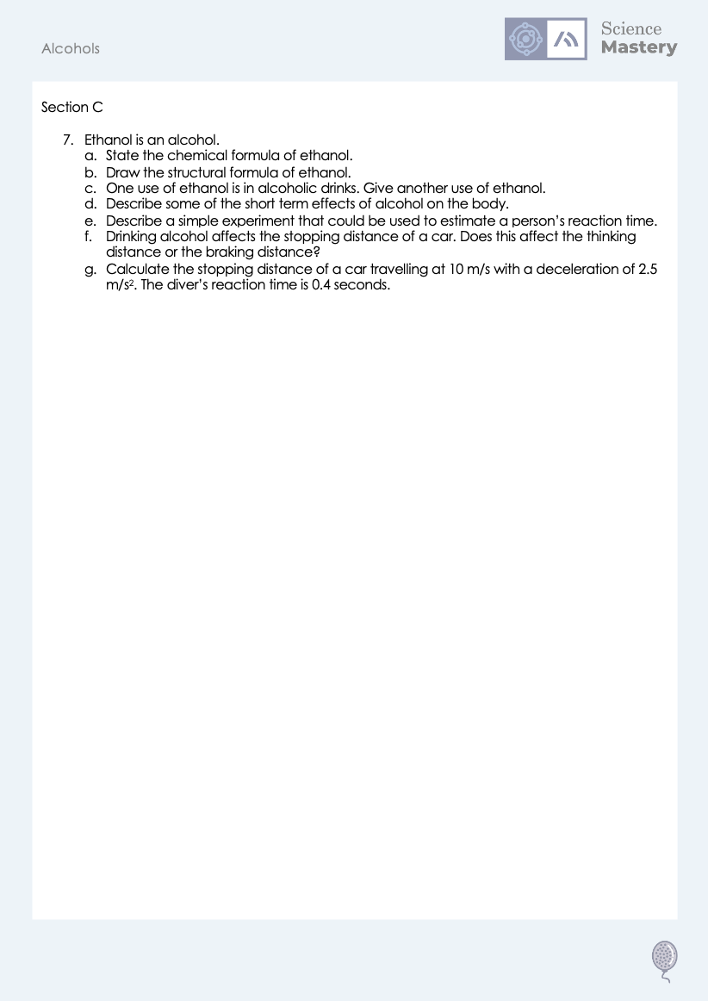
Worksheet

Slide 20
Answers
1. C - Ethanol
2. A - Hydroxyl group
3.
H
H
H
H
C
C
C
O
H
H
H
H
4a. C₆H₁₃OH
4b. C₈H₁₇OH
4c. C₁₀H₂₁OH

Slide 21
Answers
5ei. Sodium ethoxide + hydrogen
5eii. Sodium propoxide + hydrogen
5a.
5eiii. Sodium butoxide + hydrogen
X
X
X
X
X
5b. As a chemical feedstock
5c. Carbon dioxide + water
5d. Both types of combustion produce water but incomplete combustion produces carbon and carbon monoxide rather than carbon dioxide.

Slide 22
Answers
6a.
In:
(5x413)+347+358+467+(3x495) = 4722 kJ/mol
Out:
(4x799)+(6x467)= 5998
Energy change = In-Out
Energy change = 4722 - 5998
Energy change = -1276 kJ/mol
6b. Exothermic as the overall energy change is negative. More energy is released when new bonds are formed than is taken in to break the bonds of the reactants.

Slide 23
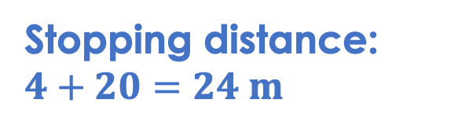
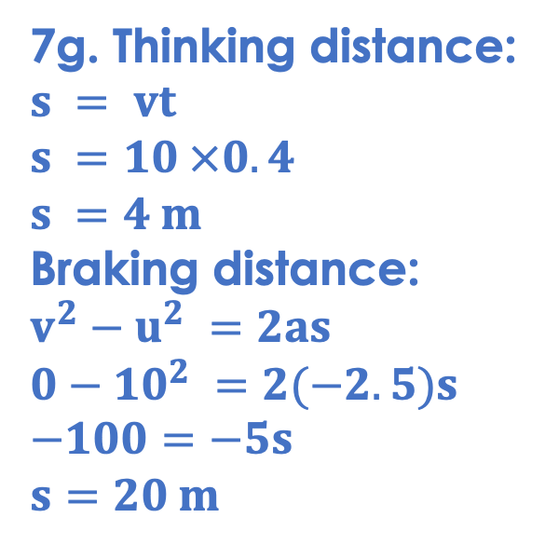
Answers
7g. Thinking distance:
$$s = vt$$
$$s =10 ×0.4$$
$$s =4 m$$
Braking distance:
$$v^{2}−u^{2} =2as$$
$$0−{10}^{2} =2(−2.5)s$$
$$−100=−5s$$
$$s=20 m$$
7a. C₂H₅OH
7b.
H
H
H
C
C
O
H
H
H
Stopping distance:
$$4+20=24 m$$
7c. As a solvent or a fuel
7d. Delayed reaction times, impaired judgement, slurred speech, altered behaviour
7e. Dropping a ruler from a given height and recording the distance the ruler fell before the person caught it. The further the ruler falls, the slower the reaction time is.
7f. Thinking distance

Slide 24
Answer the questions below.
What is the chemical formula of ethanol?
A. C₂H₅O
B. C₂H₅OH
C. CH₃OH
✓
Which is a use of methanol?
A. In alcoholic drinks
B. As a chemical feedstock
C. As a fuel
✓
What is the pattern in solubility of the alcohols?
A. The longer the chain, the more soluble it is
B. The longer the chain, the less soluble it is
C. The longer the chain, the less reactive it is
✓
Notes:
Q1. Answer: B
If students answer A, they have not identified the importance of the hydroxyl group. If students answer C, they have confused the formulae of methanol and ethanol. To fix it, review the general formula for the alcohols and the naming conventions.
Q2. Answer: B
If students answer A, they have confused the use of methanol and ethanol. If students answer C, they have confused the use of methanol with propanol and butanol. To fix it, review what each of the alcohols is useful for.
Q3. Answer: B
If students answer A, they have not identified the correct pattern. If students answer C, they have not understood the difference between reactivity and solubility. To fix it, review what is meant by solubility and the pattern of solubility in the alcohols.

Slide 25
Lesson C5.1.7
What was good about this lesson? | What can we do to improve this lesson?
Send us your feedback by clicking this link
or by emailing sciencemastery@arkonline.org
Thank you!

